Slide 1

Credit Risk Assessment Pipeline: Real-Time Credit Data Processing & Risk Analytics using Azure & Databricks
B.Kumara Swamy
Astha Kesharwani
D.Vaishnavi
K.Rajkumar
P.Bhanu Bharath
B.Naga Pavan Kumar

Slide 2
Project Overview & Objectives
Built a cloud-based ETL pipeline to process credit risk data from multiple sources.
Implemented Medallion Architecture using ADLS Gen2 and Databricks — Bronze → Silver → Gold.
Used Azure Data Factory and PySpark/DBT for data ingestion, cleansing, and transformation.
Integrated applicant, credit history, loan, and economic datasets into a unified data platform.
Prepared analytics-ready credit risk data to support loan assessment, reporting, and dashboards.

Slide 3
Problem Statement
Managing large volumes of credit and loan data from multiple source datasets.
Handling missing, duplicate, and inconsistent data to maintain reliable credit information.
Integrating applicant, credit history, loan, and economic data into one unified pipeline.
Identifying high-risk applicants efficiently using accurate and standardized credit data.
Providing trusted risk insights and reports to support faster and better loan approval decisions.

Slide 4
Technology Stack
ADLS Gen2 — Data Lake Storage
ADF — Data Ingestion & ETL
Databricks — Data Processing
PySpark — Data Transformation
Delta Lake — Data Storage
DBT — Data Transformation
Airflow — Workflow Orchestration
Pytest — Data Quality Testing
Databricks SQL — Reporting & Dashboards
Slack — Pipeline Alerts

Slide 5
Design Solutions for building Pipelines
High Level Design
Low-Level Design

Slide 6
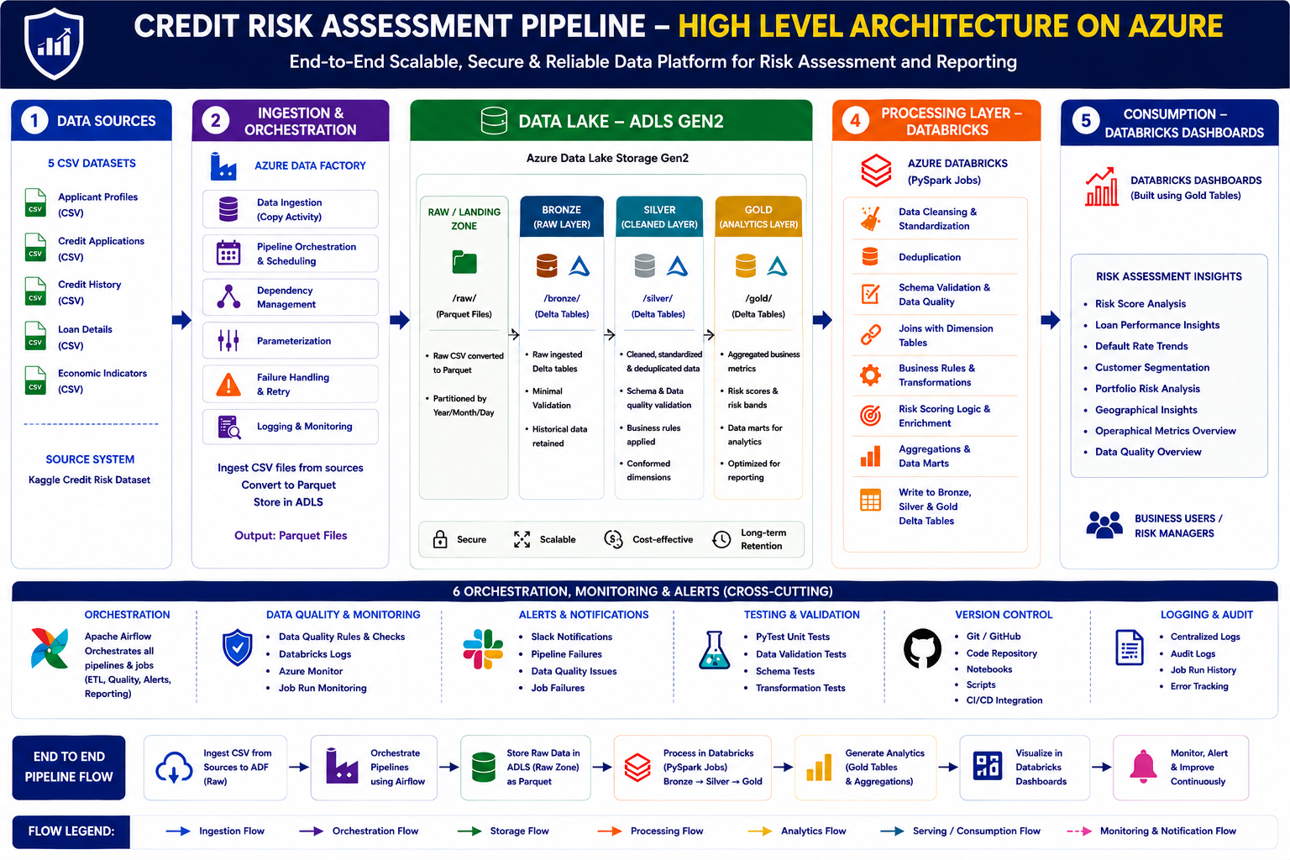
Lakehouse Architecture (High - Level Design)

Slide 7
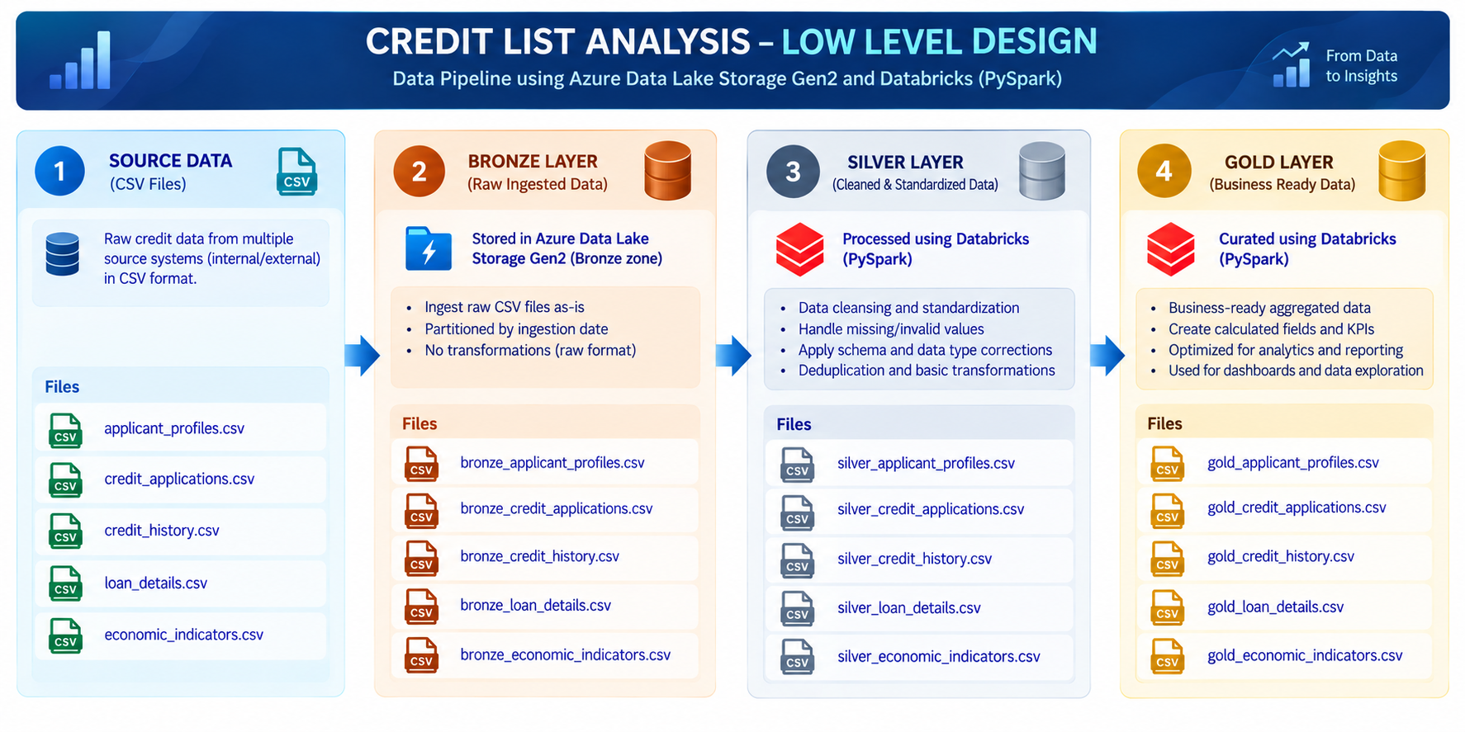
Low-Level Design

Slide 8
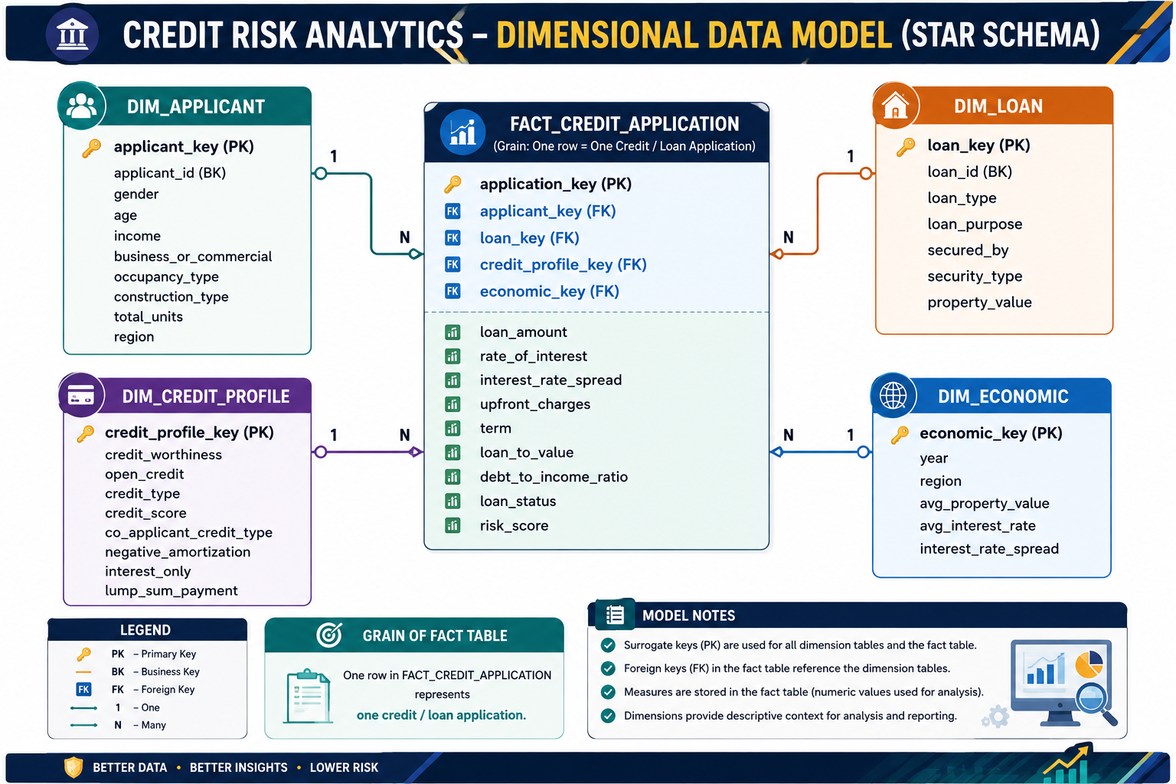
Credit Risk Analytics(Star Schema)

Slide 9
Data Quality & Error Handling
Performed schema validation to ensure correct data types and table structure.
Applied null checks and data completeness validation across credit datasets.
Implemented duplicate detection and removal for applicant and loan records.
Applied data standardization for inconsistent values, formats, and categories.
Implemented error logging and pipeline monitoring for failed Databricks/DBT tasks.
Validated Silver and Gold outputs to ensure accurate and reliable credit risk data.

Slide 10
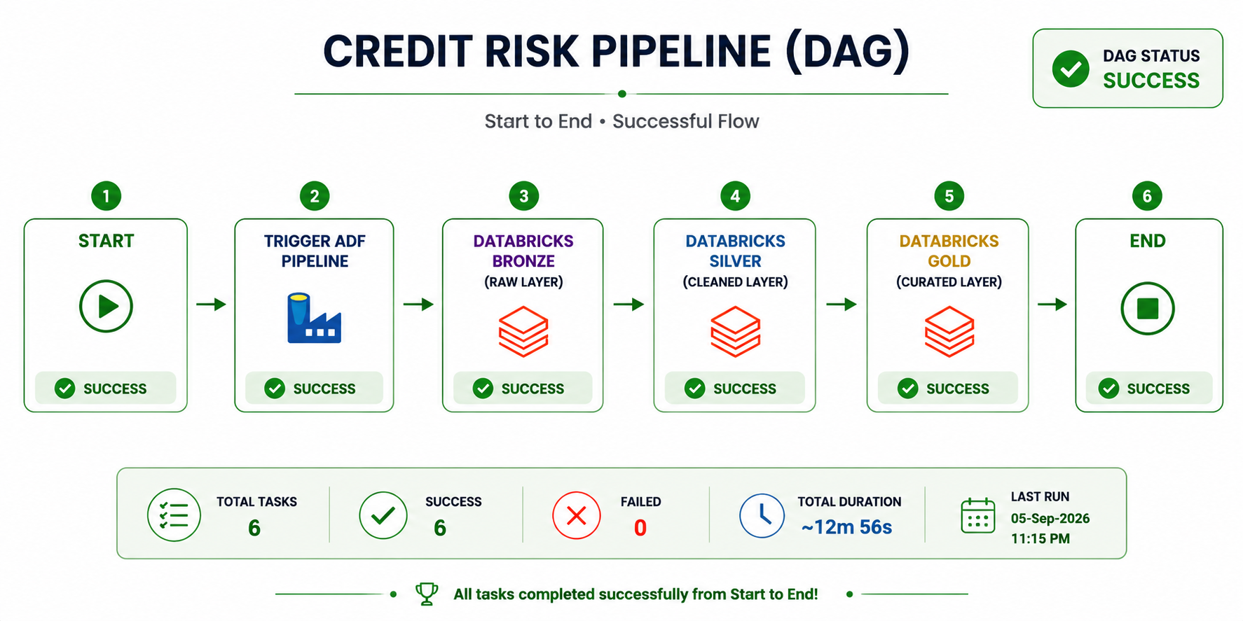
Pipeline Orchestration(Airflow DAG)
Designed an Apache Airflow DAG to orchestrate the Credit Risk ETL pipeline.
Triggered ADF and Databricks pipelines for sequential data processing.
Managed task dependencies to execute Bronze → Silver → Gold in the correct order.
Implemented failure handling, retries, and monitoring using Airflow logs.
Monitored pipeline execution and task status to ensure successful completion.

Slide 11
Alerts & Monitoring (Slack Integration)
Created a Slack channel for Credit Risk Pipeline
Configured Slack webhook integration for pipeline notifications.
Enabled Databricks Job success and failure alerts.
Sent real-time notifications for pipeline execution status.
Monitored Bronze → Silver → Gold job and task status.
Configured retry and failure notifications for failed tasks.
Tracked execution logs and alerts for faster troubleshooting.

Slide 12
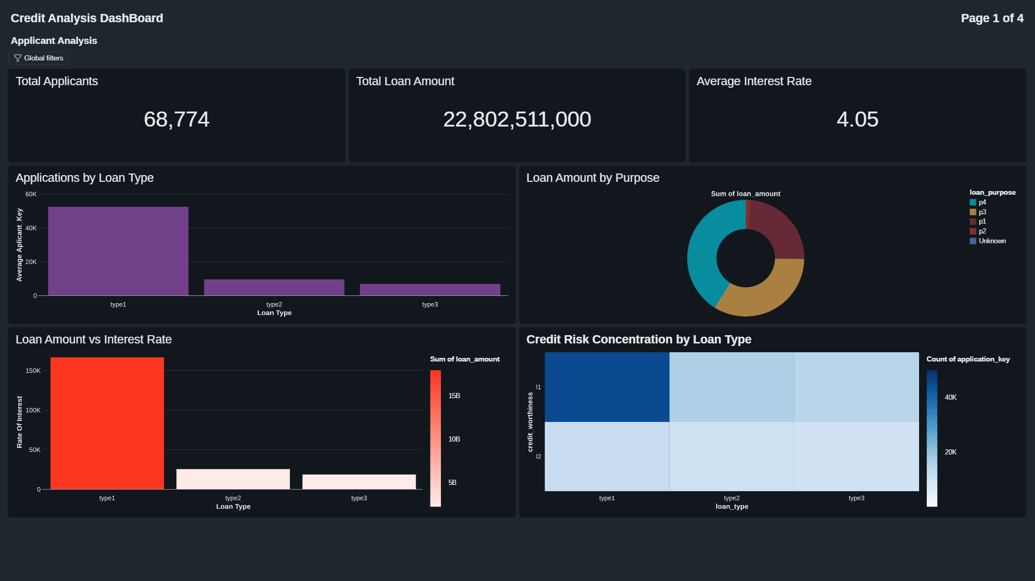
Dashboards

Slide 13
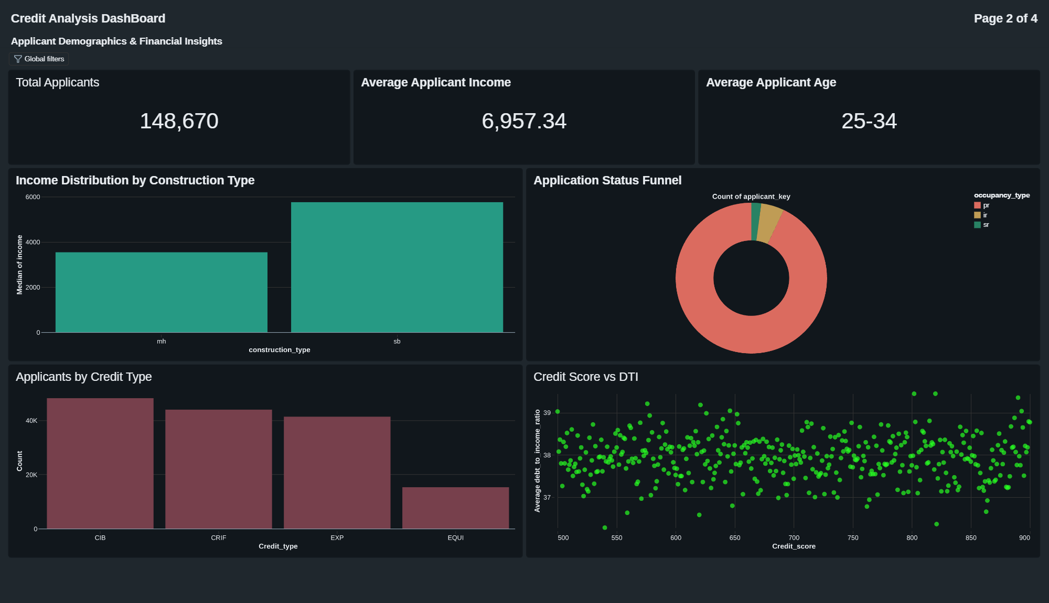
Applicant Demographics & Financial Insights

Slide 14
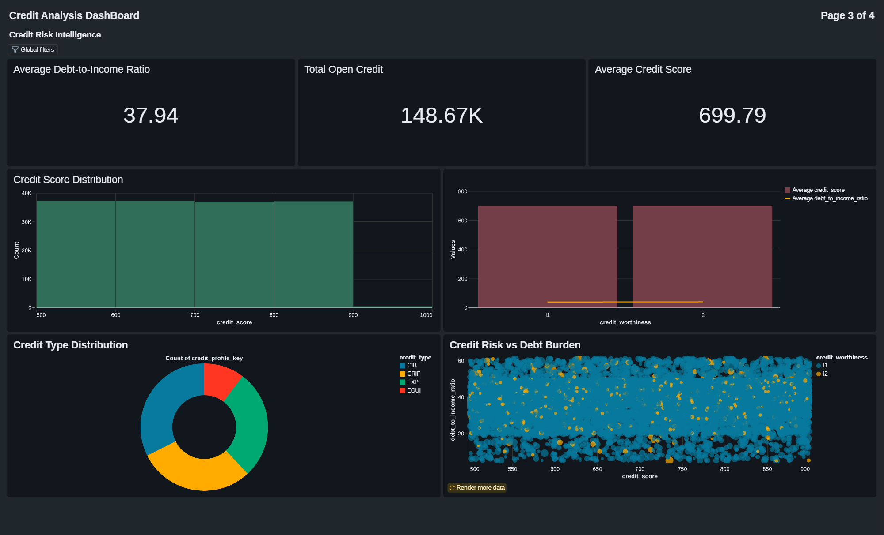
Credit Risk & Intelligence

Slide 15
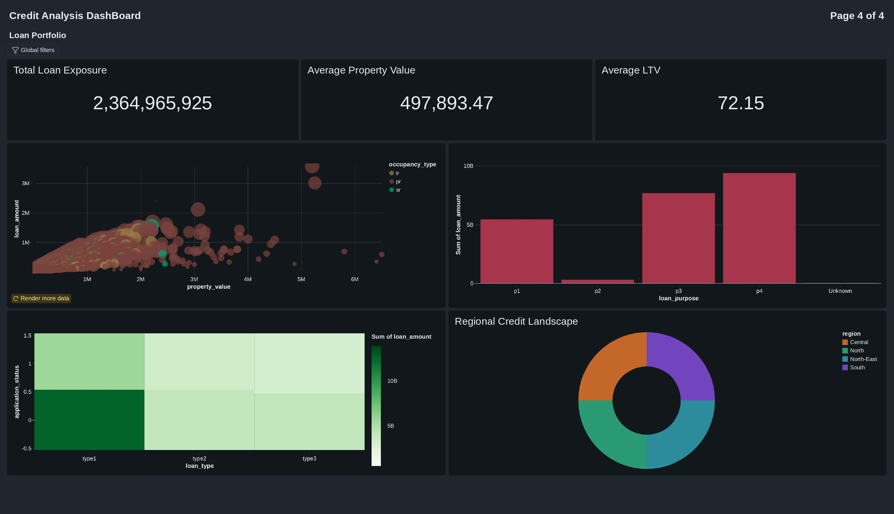
Loan Portfolio DashBoard

Slide 16
Business Insights & Outcomes
Enabled accurate credit risk assessment using applicant, loan, credit history, and economic data.
Categorized applicants into High, Medium, and Low risk using derived risk scoring logic.
Improved data-driven loan decisions through centralized and standardized credit data.
Reduced data inconsistencies and duplicate records through automated ETL and data-quality checks.
Delivered actionable credit risk insights through Gold-layer metrics and Databricks dashboards.
Improved pipeline scalability and performance using ADLS Gen2, Delta Lake, and Databricks.
Enhanced pipeline reliability with automated monitoring, Slack alerts, and Pytest validation.

Slide 17
THANK YOU!

